Slide 1


Slide 2


Mohammad Ali Jinnah University
Investiganza
Supervisor: Sir Shahroz Bakht
Group: SP22-FYP-0022

Slide 3
Mohammad Ali Jinnah University
Group Members
Muhammad Subhan Raza (SP19-BSSE-0026)
Sana (SP19-BSSE-0059)
Sonia (SP19-BSCS-0022)

Slide 4
Mohammad Ali Jinnah University
Background
Establishing the new businesses by business makers and for investors to invest their money is a big problem. we need to bring some change by providing such a platform or market place that facilitate the meeting of investors and business makers for the purpose of business deals and agreements

Slide 5
Mohammad Ali Jinnah University
Problem Statement
To start a business or invest money for the business is extremely difficult as it’s quite difficult to trust the parties involved in it and more specifically finding the investor, for not having such a platform that facilitate the meetings of involved parties by sharing the same medium.

Slide 6
Mohammad Ali Jinnah University
Significance of Problem
Today technology is everywhere and the business and new start-ups are evolving on it. Putting these ideas into action require the capital amount. The proposed system will act as a hub where all the ideas are there and Investors will invest in return of profit sharing.

Slide 7
Mohammad Ali Jinnah University
Proposed Solution
An online hub involving the people who have ideas to start-up or want to extend their business, and the people who are willing to invest. The proposed solution will help in bridging the gap between the both parties. Finance Seeker will post the query with requirements and Investor will response on it and show interest using the feature of investment proposal. The proposed system will ensure the safe communication between both.

Slide 8
Mohammad Ali Jinnah University
Comparative Analysis
Investor Hunt | Flippa | Investiganza
Availability: UK, US | Availability: Everywhere | Availability: Around the globe specially in Pakistan
Complex to understand | Easy to understand | Easy to start
Core: Bridging the gap between Investor and Finance Seeker | Core: Selling and Buying the entire business | Core: Bridging the gap between Investor and Finance Seeker
Between Investor and Finance Seeker | Entire Business | Between Investor and Finance Seeker

Slide 9
Mohammad Ali Jinnah University
Methodology
Necessary research
Design the Prototype
Frontend Development by using React Js for web App
Backend development by using .NET Core Frame work (API)
Creating the Databases for the App
Firebase and MS SQL

Slide 10
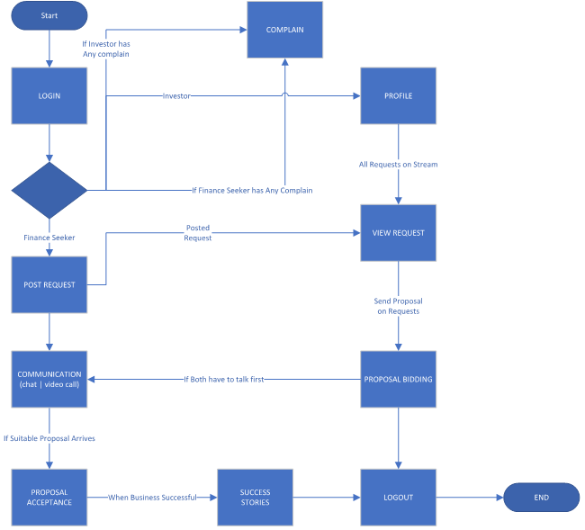
Mohammad Ali Jinnah University
Architecture

Slide 11
Mohammad Ali Jinnah University
Features of the Project
Bid Proposal & Join hand
Registration and Request Match
Ratings and Success Stories
Chatting and communication Record
Automated user blockage and Complains
Schedule Meetings

Slide 12
Mohammad Ali Jinnah University
Project Distribution
FYP-1
Requirements Gathering & Analysis
M Subhan Raza (33%)
Sonia (33%)
Sana (33%)
Prototyping and Designing
M Subhan (15%)
Sonia (60%)
Sana (25%)
Front-end Development using React.Js
M Subhan Raza (25%)
Sonia (25%)
Sana (50%)
Database Design and Development
M Subhan Raza (60%)
Sonia (20%)
Sana (20%)

Slide 13
Mohammad Ali Jinnah University
Project Distribution
FYP-2
API Development
M Subhan Raza (70%)
Sonia (30%)
Chatting Module Integration
M Subhan (50%)
Sana (50%)
Unit and Integration Testing
M Subhan (20%)
Sonia (30%)
Sana (50%)
Documentation
Sonia (70%)
Sana (30%)

Slide 14
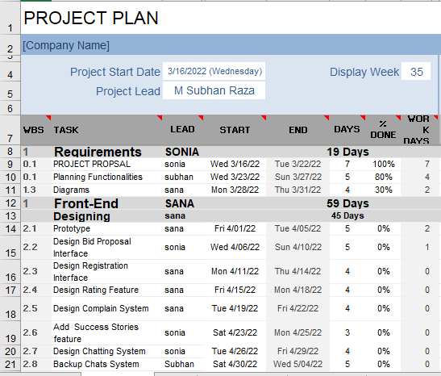
Mohammad Ali Jinnah University
Project Plan

Slide 15
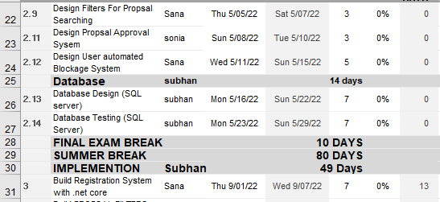
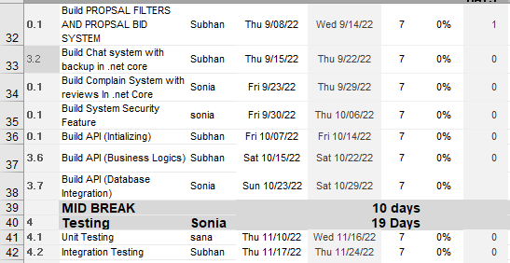
Mohammad Ali Jinnah University
Project Plan

Slide 16
Mohammad Ali Jinnah University
Potential Users / Clients
Those who have a proper realistic business idea for their start-ups but suffer financial backup.
Those who are running business but want to extend it on a large scale and need bigger financial support.
Those who are financially stable and want to invest money in new business or existing business for a remarkable return.

Slide 17
Mohammad Ali Jinnah University
References
Flippa (Application)
https://flippa.com/
Investor Hunt (Application)
https://investorhunt.co/

Slide 18
Mohammad Ali Jinnah University
THANK YOU! ☺

